Slide 1

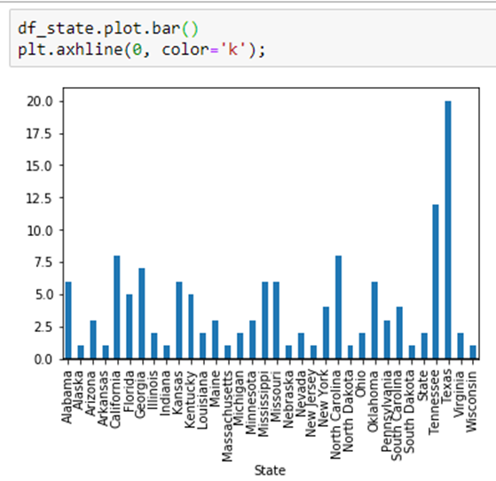
Rural Hospital Closure Risk
On the top of opioid crisis, high unemployment rate, American rural hospitals are closing in average of 10 per year. The topic seems to have gained a lot of interest from experts who try to understand the underlining factor in this new trend.
The purpose of this dashboard is to explore the data of US rural hospital closure from 2005 to 2019.
Data resource: https://www.shepscenter.unc.edu/programs-projects/rural-health/rural-hospital-closures/
Acknowledgment:
https://github.com/ksu-hmi/Hospital-Dashboard via Bonnie McDaniel
https://github.com/jvns/pandas-cookbook
By Victor Casanova and Francis Kouakou

